Slide 1
Boosting Algorithm(REGRESSION) Assignment
Ada Boost Algorithm
XG Boosting
LG Boosting(Light Boosting)

Slide 2
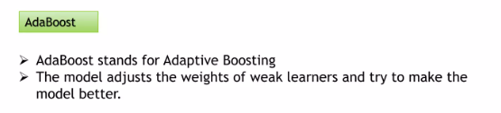
Ada Boost Algorithm
Next How The Algorithm Works

Slide 3
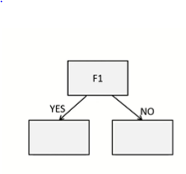
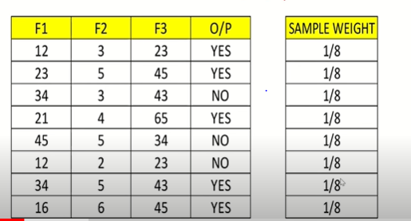
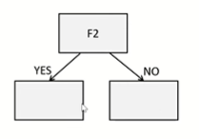
Step1: Sample Weight Creation
Step2: Stump Creation
One Depth(F1,F2) Two Leaf Node(YES,NO)
(STUMPS)

Slide 4
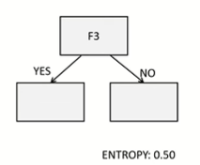
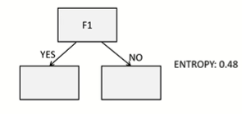
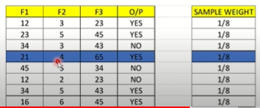
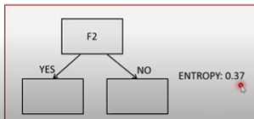

Step3: Stump Selection
Step4: Calculate Total Error(TE)
Between 0 and 1
TE=Sum Of Misclassified records
Find Minimum Value Of Entrophy or Gini Index

Slide 5
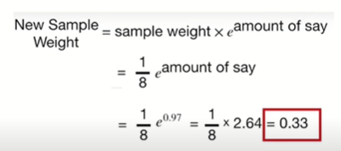
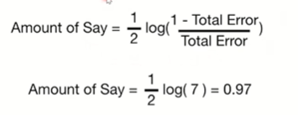
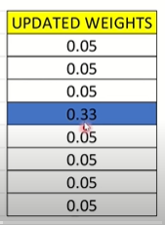

Step5: Calculate Amount Of Say or
PERFORMANCE SAY
Step6: Update Weight
(This is for Misclassified Column)
(This is for Other than Misclassified Column)

Slide 6
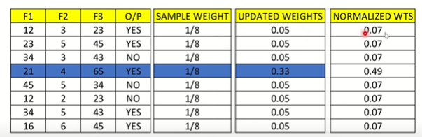
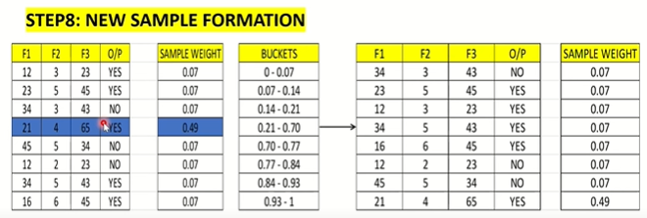
Step7: Normalize the Weight
Normalised Weight=Total Sum of Updated Weight/Total No Of Rows
=0.05/0.68=0.07
And =0.33/0.68=0.49
Step7: New Sample Formation
Bucket=Sample weight Intervals
This is New Data set
Again go to Step2

Slide 7
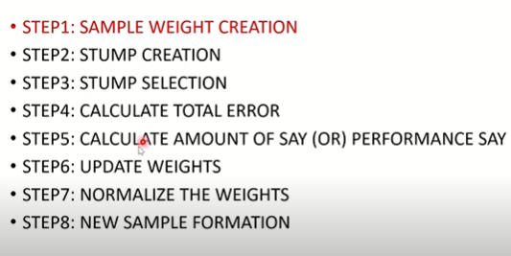

Slide 8
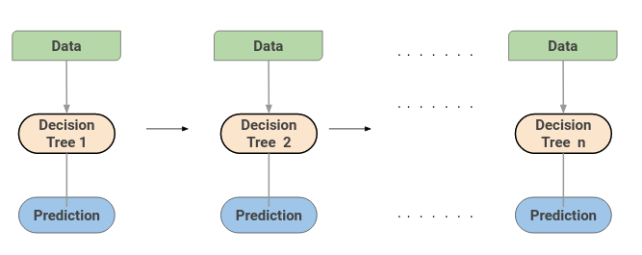
(Gradient Boosting)
GBM combines the predictions from multiple decision trees to generate the final predictions.

Slide 9
In simpler terms, this algorithm creates a series of decision trees where each tree tries to correct the errors made by the previous ones. Here’s how it works:

Slide 10
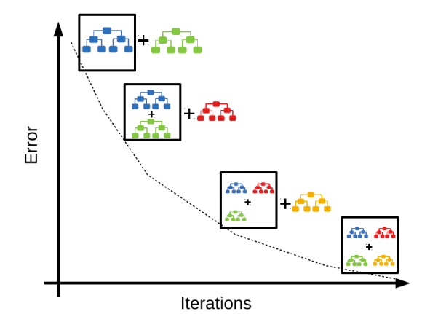

Slide 11
The first tree makes predictions on the data, with
some errors.
The second tree comes in and focuses specifically on the
places where the first tree went wrong, trying to correct
those errors.
The third tree then works on the mistakes that are still
present, and so on.
This process continues, with each new tree in the series
focusing on reducing the errors from the previous trees,
until we have a collection of trees that, together, make
very accurate predictions.

Slide 12
XGBoost Algorithm
When it comes to a superfast Machine Algorithm that works on tree-based models and tries to reach the best in class accuracy by optimally using computational resources, XGBoost or Extreme Gradient Boosting becomes the most natural choice.
Example: Think of it like a group of friends helping you decide if a fruit is an apple or an orange based on its colour, size, and shape. Each friend focuses on a specific detail and gives their opinion. XGBoost combines all their opinions to make a super accurate guess. It’s great at many tasks, like guessing movie ratings based on reviews.

Slide 13
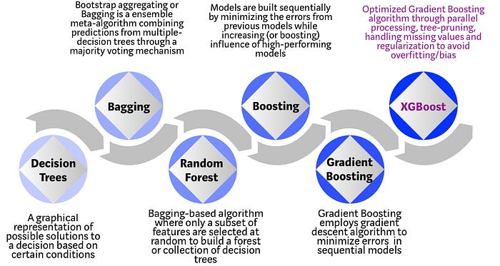

Slide 14
Why does XGBoost perform so well?
XGBoost and Gradient Boosting Machines (GBMs) are both
ensemble tree methods that apply the principle of boosting
weak learners using the gradient descent architecture.
However, XGBoost improves upon the base GBM framework
through systems optimization and algorithmic enhancements.

Slide 15
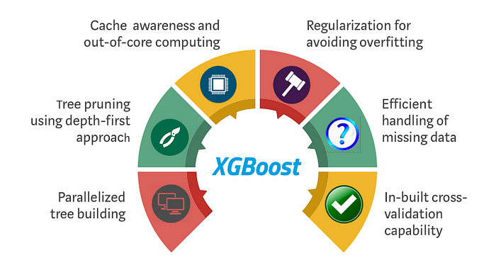
How XGBoost optimizes standard GBM algorithm

Slide 16
LightGBM
Similar to XGBoost, LightGBM (by Microsoft) is a distributed high-performance framework that uses decision trees for ranking, classification, and regression tasks
Advantages
Faster training speed and accuracy resulting from LightGBM being a histogram-based algorithm that performs bucketing of values (also requires lesser memory)
Large Amount of Data Easy to Handle
Poor in Small Dataset (Disadvantage)

Slide 17
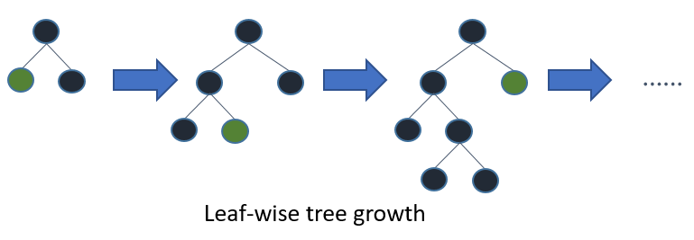
In contrast to the level-wise (horizontal) growth in XGBoost, LightGBM carries out leaf-wise (vertical) growth that results in more loss reduction and in turn higher accuracy while being faster.

